Slide 1
Summary Report for BFX–UA300
Quality Issue on Jun-2022 Product
Prepared by: Rachel Ruan
Reviewed by: Toney Tu
Approved by: CB Lin
Date: 2022-Aug-18

Slide 2
Issue Description
On 2022-Jul-07, ALT customer complain that BFX-UA300 inspection fail of MP delivered on Jun-2022.
Overall inspection result:
Failed.
  Cancel Sampling Inspection
  Apply full (4000pcs) inspection
This inspection result is impacted ALT quality level.
Defect Total:
• Critical
  No boot 2pcs
  No Ethernet 1pcs
  Ethernet unstable 1pcs
• Major
  HDMI cable defect 5pcs

Slide 3
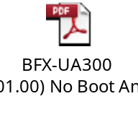
1.1. No boot
Issue Description | FA | Root cause | Actions | Status
Symptom: No boot. Defect Q’ty : 1/1088pcs Defect rate : 0.09% SKB SN: 2149695001202201009341 | Check FATP data → Product test pass normally. Check RMA product cosmetic → Pass. Check boot up → Boot up fail. Take X-ray SoC, Ram, eMMC → Normal. Measure voltage of NG sample → Normal. Measure crystal signal at BG5_CLKI pin of Y2 (Block) by oscilloscope → Normal. Re-assembly NG sample into housing → Boot up fail. Re-Open housing and check PCBA carefully → Found Pin of R2994 too long to short with heatsink ( From 24V to 0V) after assembly. Assembly NG sample into housing after cut pin of R2994 to verify product’s function → Pass. | The pin of R2994 is height to short with the heatsink (24V to 0V), caused the boot up fail. | Change the component leg length from 3.2±0.4 mm to 3.2±0.1 mm after cutting and update the cutting SOP. (IE: Haily, Done) Using fixture to check the Pin length, and update the SOP to add OK and NG pictures. (IE: Haily, Done) Train PTH VI to check the pins of R2994. (PD: Wen-yong, Done) Update: PE verify 01 units R2994 short 24V with hear sink --> Product Can not boot up and no console log. (PE: Jack Han, Done 02-Aug) | Closed

Slide 4
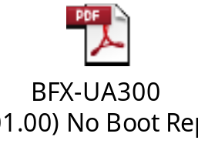
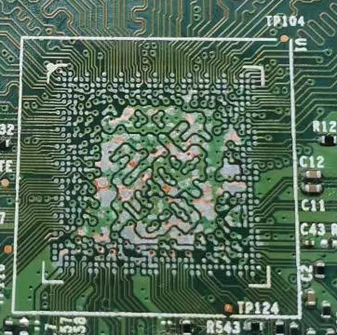
1.2. No boot
Issue Description | FA | Root cause | Actions | Status
Symptom: No boot. Defect Q’ty : 1/1088pcs Defect rate : 0.09% SKB SN: 2149695001202201011465 | Check FATP data → Product test pass normally. X-ray inspection SoC, Ram, eMMC → Normal. Measure voltage of NG sample → Normal. Measure crystal signal at BG5_CLKI pin of Y2 (Block) by oscilloscope → Normal. Re-assembly NG sample into housing → Boot up fail. When Swap new BGA & eMMC progress → Appear abnormally ( pad peeling in U1 location) → Can’t further analyze anymore. | Suspect this issue relate to Soc_U1. | 1. Please ALT sent more NG sample for more analysis. 2. Fii test run in power on, 2 hours/ pcs . Quantity test: 1K. Apply next build ( waiting for customer green light). Due date: Aug-2022. | Monitor

Slide 5
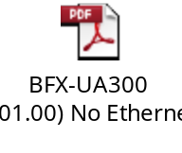
2. No Ethernet
Issue Description | FA | Root cause | Actions | Status
Symptom: Ethernet does not work Defect Q’ty : 1/1088pcs Defect rate : 0.09% SKB SN: 2149695001202201009369 | Check SFIS data, no abnormal. PT station test program will check Ethernet Led (Led Green and Yellow) and test Ethernet CRC and throughput ->This issue can cover at PT station. Check VI, Take X-ray and Measure voltage & impedance → Normal Plug Ethernet wire → Ping abnormal, Led_Link(yellow) no light, Led_Act(Green) is always on. Power on, connect internet and watch Youtube at OBA in 2h → Product lost ping and can’t connect to the network Re_solder U801 and replace by new U801 ➔ Still NG. Re_solder Soc_U1 ==> Ping normally Retest PT and OBA → Pass. Power on and watch video by external internet at OBA station within 4hours → Did not lost ping and watch video normal. | Re_ball & mounting the BGA U1, the product function pass. Suspect BGA U1 (IC PER, vendor: SYNAPTICS) soldering issue. | Continue to verify this product reliability do longer time to power on and power on/off and then do thermal shock, no abnormal found. (PE: Michael, done on Aug-3) Fii perform vibration test 2 carton. Then power On test 2 hours. Result test: No abnormal issue (PQE: Toney Tu, Done: Aug-05). Fii perform strain gauge test for PCBA assembly / testing station, Result ; follow normal process no strain gauge risk issue online. (ME: Cheng-lun, Done: Aug-05). 4. Fii test run in power on, 2 hours/ pcs . Quantity test: 1K. Apply next build ( waiting for customer green light). Due date: Aug-2022. | Monitor

Slide 6

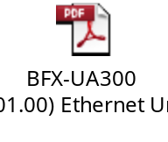
3. Ethernet unstable
Issue Description | FA | Root cause | Actions | Status
Symptom: Ethernet unstable Defect Q’ty : 1/1088pcs Defect rate : 0.09% SKB SN: 2149695001202201008099 | Check FATP data → Product test pass normally. At PT station: test program will test Ethernet CRC and throughput → This issue can cover at PT station. Check VI and take X-ray Ethernet block → Normal. Measure impedance and voltage of Ethernet block → Normal. Use oscilloscope to measure crystal frequency → Normal. Check ping → Normal. Retest NG unit at OBA → Ethernet unstable, Ethernet speed too low. Re_solder U801 and retest OBA → Still NG. Replace a new U801 and retest PT & OBA → Pass | This issue follow PER IC U801. (P/N:002.02152.005, Vender: Realtek, D/C: DL50) | 29-Jul vendor received the NG samples. 12-Aug , Realtek provide the first FA report ver, but Fii was reject because FA report not clean. 16-Aug, Realtek update 2nd ver FA report, confirm defect IC is NTF. 16-Aug, RD request Realtek re-send defect IC to RD TW for more analysis. RD: Sean/Tom Lee. 17-Aug, RD received defect IC. Waiting RD update TX, RX1000Mbps without delay. Due date : 19-Aug | Ongoing

Slide 7
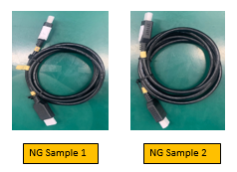
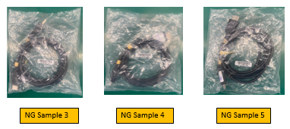


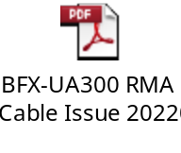
4. HDMI cable defect
Issue Description | FA | Root cause | Actions | Status
Symptom: HDMI cable defect Defect Q’ty : 5 pcs DC: 220421 & 220413 | Check HDMI data: PN: 371.01057.005 Vendor : FIT Check visual on the surface of cable ➔ No abnormal found. After inspected cable head by X-Ray and compared with OK Sample, FII detected wire structure of Sample:1,2,3,4,5 abnormal. We connected HDMI cable with product & TV to check function of HDMI Cable and detected abnormal as bellow: Sample 1: Unstable signal Sample 2: No signal Sample 3,4,5 : Interference signal | FIT HDMI cable material issue. The pin copper wire of HDMI cable is broken & pin copper wire is not placed properly and is not placed in the corresponding pin slot. | Short term action: 1. FIT 100% sorting the HDMI cable and mark white point at the HDMI cable, sorted 35242 pcs to Aug-17, no defect found. Stock DC: 220615, 220624, 220708, 220715 (Done: Aug-17). 2. Fii had rework 1080 units from finish good stock : Done 10-Aug. Long term action: FIT improved the HDMI cable from D/C 08.2022. | Close

